Slide 1

OOP Part 2
Kia Babashahi Ashtiani

Slide 2
Outline
Constructors
Setters,getter and constructors
Method Overloading
Static
Final

Slide 3
Primitive type vs reference type
Primitive type variables are initialized by default.
When an object is created, its fields have to be initialized.
The constructor does this job for us.
Java calls the constructor for every object created from a class.

Slide 4
Constructor
The element that initializes and constructs the object created from a class.
It must have the same name as the class.
Think of ordering food:
You might want to set the level of saltiness of your food in advance when ordering it.
You might ask the chef to cook it without salt and then you adjust its salt level.
You can create your object and then initialize its fields to the values you want by setters.
You can also set some/all of the fields that you want while creating the object (using the constructor).

Slide 5
Class constructor
Public ClassName(type Parameter 1, type parameter 2){
Field1= parameter1; Field2=parameter2; , …
}
You can have multiple constructors depending on the project requirements.
Some times you want to set all of the attributes upon creating the object.
Some times you want to set some of the upon creating the object.
Some times you want to leave all of them to the setters and public variables.

Slide 6


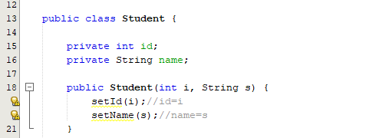
Creating a constructor
The constructor is setting the value of the fields.
Please keep in mind that in this case you can also have private setters.
Another way of doing the same thing (if the setter is only an assignment) is to write name=s; id=i. (look at the comments)

Slide 7
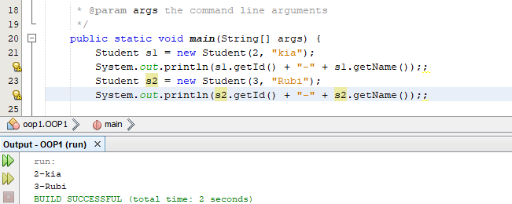
Creating objects (scanners)
Using the constructor to set the values of the fields of the student class.

Slide 8
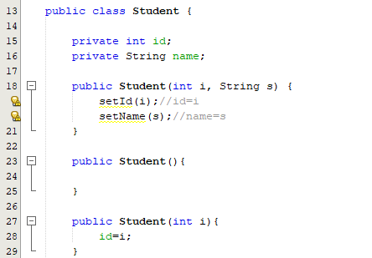
Adding multiple constructors
Multiple constructors can be defined depending on what you want to do.
If no constructor is written in a class, Java will automatically assume that the constructor is empty.

Slide 9

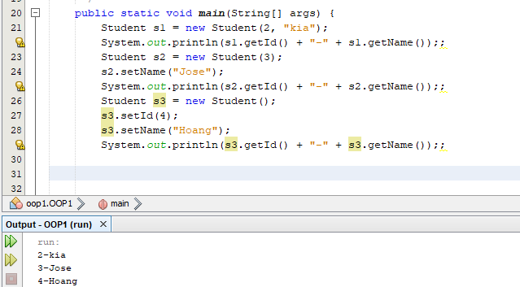
Calling multiple constructors

Slide 10
Method overloading
Method max is responsible for finding the max value between two numbers n1 and n2.
When writing the method we need to specify the type of its input arguments.
If max is written for integer numbers, then it can`t be called on double variables.
What can we do?
Having multiple max functions with different input arguments would work.
This is called method overloading.

Slide 11
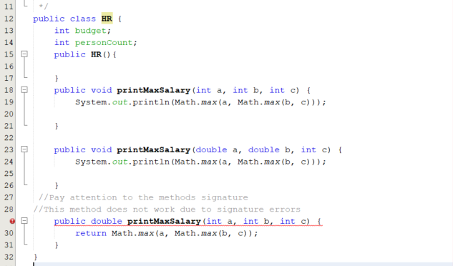
Code for method overloading
The first two are examples of method overloading.
The methods name, the order of the variables and their types is called the method’s signature.
Methods should have different signatures in this case.
Overloaded methods can have different return types if they have different signatures

Slide 12
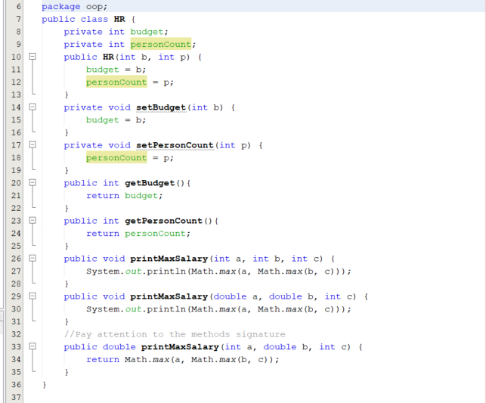
Overloading2
The final version of the class looks like This.
Pay attention to the change in the signature of the last method.

Slide 13
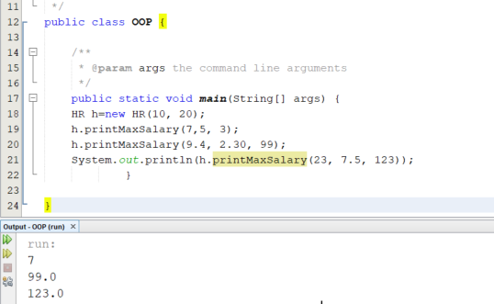
Calling the methods
You can call the methods the way you want.
Please note that the HR class is not a real-life example of an hr class and it is just used to introduce method overloading.

Slide 14
Static variables
When the method preformed a task without being dependent on the content of any object math.abs(-2).
Static fields are used for the same purpose. If they will be used for a common purpose independent on the content of the object that is calling them.
Math.pi is an example of a static variable.
When defining a variable to be static, it will be launched into the memory and kept there.

Slide 15
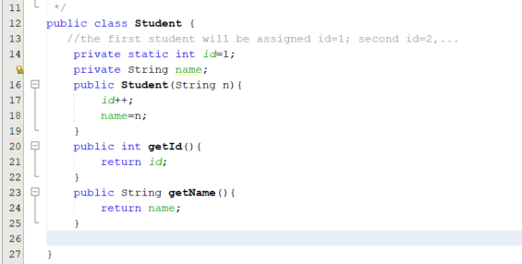
Static var exp
Suppose we want to allocate ids to students.
Let's assume we want this to be done automatically.
The first student gets id 1, the second one gets id 2, ….
The field id should be declared static so its loaded into the memory and not re-initialized each time like the name field.

Slide 16
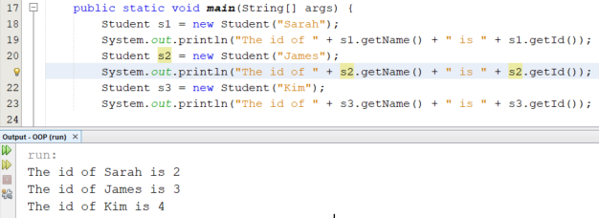
Initializing static variables

Slide 17
Garbage collection
the way Java programs preform automatic memory management. If there is an un-used variable , it will be deleted. In many cases if the variable is unreachable.
Static variables can only be garbage collected if the class loader which has loaded the class in which the static field is there is garbage collected in java. Taken from Here.

Slide 18
Final variables
A final variable, a final field, is initialized once and can never be changed after.
As a matter of fact math.pi and math.e in the math package are final static variables

Slide 19
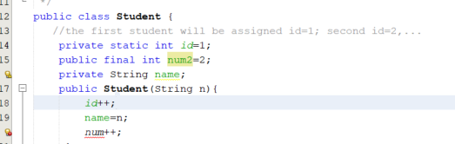
Coding examples

Slide 20
Next week
Nested classes
shadowing
Unit tests
Debugging

